Slide 1
Ulwazi mayelana nokumelana nemishanguzo yeHIV

Slide 2
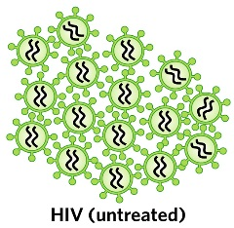
Kuyini ukumelana nemishanguzo yeHIV?
Uma umuntu etheleleka ngeHIV, igciwane lingena emzimbeni womuntu bese liqala ukwenza umfanekiso walo.

Slide 3
Imishanguzo esetshenziselwa ukwelapha iHIV ibizwa ngama antiretrovirals (ARVs).
Notes:
Ukuthatha ama-ARVs ngendlela kuvame ukusho ukuthi uthatha izinhlobo eziwu 3 ezihlukene, ngoba kuthatha ngaphezulu komuthi owodwa wama-ARVs ukuvimbela iHIV ukuthi iziphindaphinde.

Slide 4
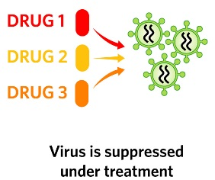
Kuyini ukumelana nemishanguzo yeHIV?
Uma ethathwe ngendlela, ama-ARVs ayalivimba igciwane ukuthi liziphindaphinde bese asiza abantu abaneHIV ukuthi bazizwe bengcono baphile isikhathi eside.

Slide 5
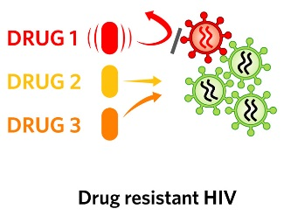
Nakuba kunjalo ama-ARVs awulungile ngokuphelele, futhi ngezinye izikhathi awakwazi ukumisa wonke amagciwane eHIV ukuthi aziphindaphinde.
Kuyini ukumelana nemishanguzo yeHIV?

Slide 6
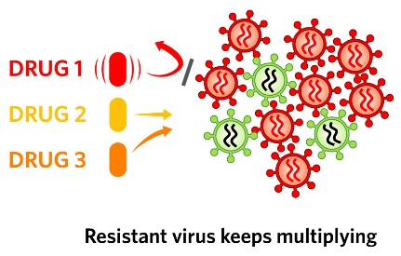
Uma lokhu kwenzeka, iHIV ikwazi ukuqhubeka ukuziphindaphinda libizwa “ukumelana“.
Kuyini ukumelana nemishanguzo yeHIV?

Slide 7
Kungani ukumelana nemishanguzo yama-ARVs kuyinkinga?
Uma ukumelana nama-ARVs kwenzeka, umuntu udinga ukuyeka ukuthatha ama-ARVs angasasebenzi bese eqala ukuthatha imishanguzo yamaARVs ahlukile.

Slide 8
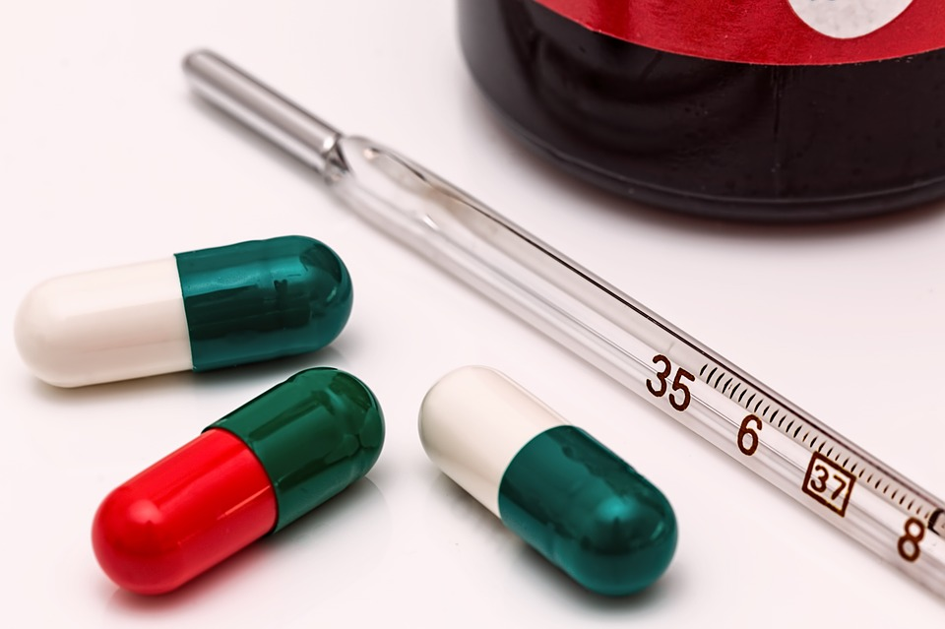
Kungani ukumelana nemishanguzo yama-ARVs kuyinkinga?
Ngenxa yalokhu, umuntu oneHIV enokumelana unokuzikhethela okumbalwa kwemishanguzo yama-ARVs angawathatha ukusizakala ukuthi bahlezi bephilile.
Ngaphezu kwalokho, bangathelela abanye ngaleligciwane elinokumelana.

Slide 9
Kungani ukumelana nemishanguzoyama-ARV’s kuyinkathazo kulolucwaningo?
Iringi yesitho sangasese sowesifazane sangaphambili iqukethe ama-ARVs abizwa ngeDapivirine. IDapivirine isetshenziselwa kuphela ukuvikela iHIV, futhi ayisetshenziselwa ukwelapha abantu asebethelelekile ngeHIV.

Slide 10
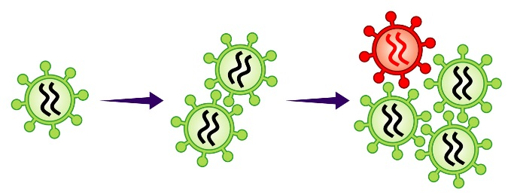
Kungani ukumelana nemishanguzoyama-ARV’s kuyinkathazo kulolucwaningo?
Nokho, uma owesifazane etheleleka ngeHIV futhi elokhu esebenzisa iringi, igciwane emzimbeni wakhe lingaba nokumelana nedapivirine kanye nemishanguzo ecishe ifane nama-ARV asetshenziselwa ukwelapha iHIV noma ukuvimbela ukutheleleka kwengane nomama ngeHIV.

Slide 11
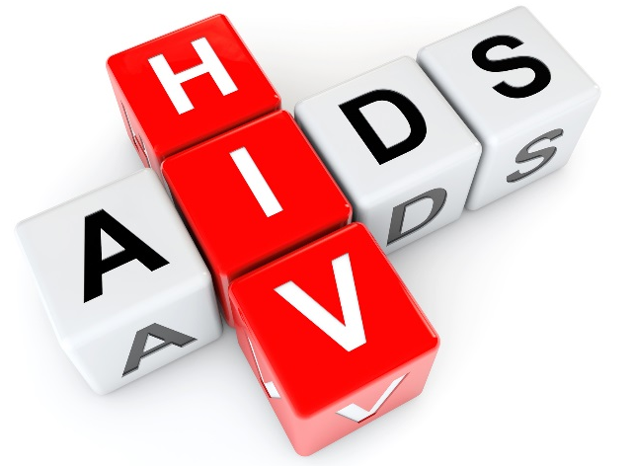
Kungagwenywa kanjani ukumelana nemishanguzo yama-ARV ngesikhathi ubambe iqhaza kuHOPE?
1. Gwema Ukuthola iHIV: Ukumelana nemishanguzo yama ARV ngeke kwenzeke kumuntu ongenayo iHIV.
Notes:
Ziningi izinto ongazenza ukunciphisa ubungozi bokutheleleka ngeHIV:

Slide 12
Kungagwenywa kanjani ukumelana nemishanguzo yama-ARV ngesikhathi ubambe iqhaza kuHOPE?
Sebenzisa idapivirine iringi yesitho sowesifazane sangasese sangaphambili njalo
Sebenzisa amakhondomu njalo

Slide 13
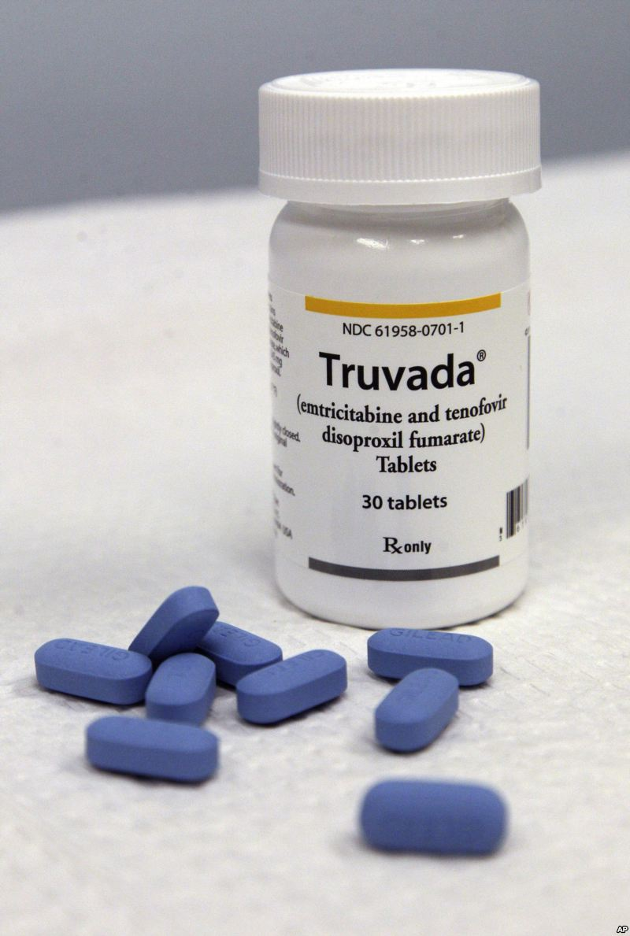
Kungagwenywa kanjani ukumelana nemishanguzo yama-ARV ngesikhathi ubambe iqhaza kuHOPE?
Sebenzisa iPrEP ephuzwayo (e.g. Truvada)
Nciphisa isibalo sakho sophathina bocansi
Zibandakanye ezindleleni zocansi ezinobungozi obuphansi

Slide 14
Kungagwenywa kanjani ukumelana nemishanguzo yama-ARV ngesikhathi ubambe iqhaza kuHOPE?
Uma uneSTI (isifo esithelelana ngokocansi), thola ukwelashwa
Gqugquzela uphathina wakho ukuthi ahlolelwe iHIV.
Uma uphathina wakho eneHIV, mugqugquzele ukuthi ayithathe ngendlela imishanguzo yakhe yama-ARVs.
Notes:
Buza umeluleki ngezincwajana ezinikezwayo zo “Ulwazi mayelana nezindlela zokuvikela iHIV ongakhetha kuzo” ngolunye ulwazi olwengeziwe kulezindlela.

Slide 15
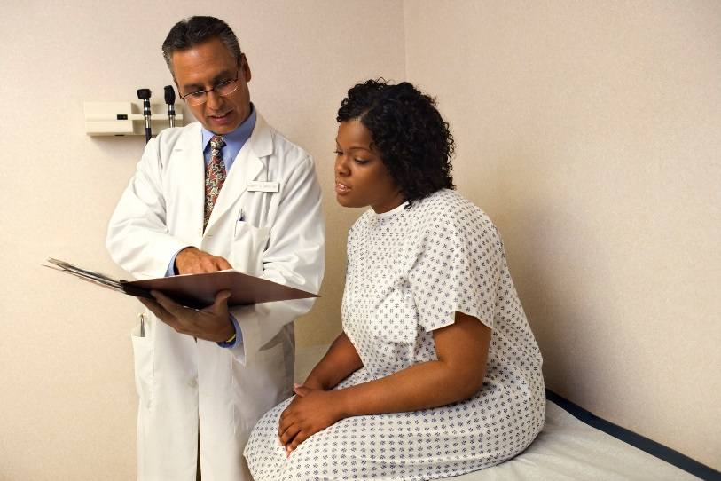
Kungagwenywa kanjani ukumelana nemishanguzo yama-ARV ngesikhathi ubambe iqhaza kuHOPE?
2. Jwayela ukuhlolela iHIV: Ukuhlolwa kweHIV kuzokwenzeka njalo ekuvakasheni kwakho ocwaningweni.
Kumele futhi uze ekliniki uzohlolela iHIV uma ucabanga ukuthi kungahle kube uthelelekile ngeHIV maphakathi nokuvakasha kwakho.

Slide 16
Kungagwenywa kanjani ukumelana nemishanguzo yama-ARV ngesikhathi ubambe iqhaza kuHOPE?
Uma ukuhlola kuveza ukuthi uneHIV, kubalulekile ukuyeka ukusebenzisa iringi yesitho sowesifazane sangasese sangaphambili ngokushesha ukusiza ukuvimbela ukumelana.
Notes:
Uma ephuthwa ukuvakasha kocwaningo, umbambiqhaza angase atheleleke ngeHIV angabi nalwazi ngalokhu futhi aqhubeke asebenzise iringi. Lokhu kungabanga ukumelana neminye yemishanguzo yama-ARVs.

Slide 17
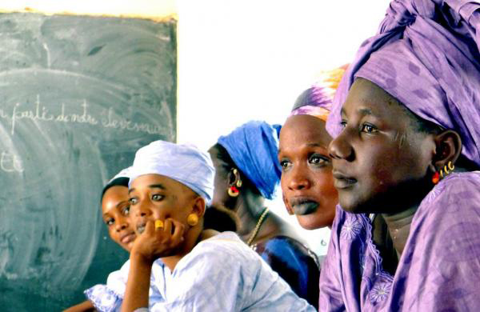
Kungagwenywa kanjani ukumelana nemishanguzo yama-ARV ngesikhathi ubambe iqhaza kuHOPE?
3. Ungabelani ngamaringi esitho sowesifazane sangasese sangaphambili:
Ababambiqhaza kulolucwaningo bathola njalo ukuhlolwa kwezempilo nokuhlolwa kweHIV. Abantu abangekho ocwaningweni abakutholi lokhu kuhlolwa kwezempilo. Labantu bangaba neHIV futhi bengakwazi lokhu.
Notes:
Uma abantu abaneHIV besebenzisa iringi yesitho sowesifazane sangasese sangaphambili, lokhu kungabanga ukumelana neminye imishanguzo yama-ARVs.

Slide 18
Uma unemibuzo noma udinga ulwazi olwengeziwe, sicela uvakashele eklinikhi yocwaningo.
Abasebenzi bocwaningo bakhonela ukukusiza
Notes:
Abasebenzi bocwaningo bakhonela ukukusiza.
Abasebenzi bocwaningo bakhona ukukwazisa nokweluleka ababambiqhaza ocwaningweni, ophathina babo, kanye namanye amalungu omphakathi mayelana nokumelana nemishanguzo yama-ARV kanye nanoma imiphi imibuzo noma ukukhathazeka abangase babe nakho.

